Slide 1
EADMT GA 2024
ANNUAL REPORT OF THE RESEARCH WORKING GROUP (05/10/2024)

Slide 2
VISION AND MISION
connect
exchange
initiate
collaborate
continuate

Slide 3
VISION AND MISION
Contributing to the circle of knowledge development on DMT related topics by
supporting EADMT members on their collaboration on European projects to create knowledge
adopting available knowledge by offering access to and distribute available research resources
participating in the conference WG by reviewing calls and conference submissions.

Slide 4
OUR PRINCIPAL TOPICS
1. European research collaboration
To facilitate participation of DMT researchers in research projects throughout Europe
To support exchange and discuss experiences around PhD trajectories
To promote exchange and discuss contents and research designs
2. Communication between National Associations & EADMT research group
how to communicate opportunities for collective submissions for funding opportunities.
how to build network on research related topics

Slide 5
ONGOING DISCUSSIONS
Be a link for connection to other researchers and professionals
To promote the philosophy of inclusion with other disciplines.
To invite colleagues from other disciplines to conferences (neurologist, psychologist, computer science, etc.)

Slide 6
RESEARCH WG TEAMS
Research database on the EADMT website
  Elīna Cauna-Ņitavska, Silja McNamara and Eduard Martin Colomer are coordinating this work for the research working group.
PhD forum - DMT Researchers Facebook Group
  Ana Coimbra Oliveira, Pauliina Jääskeläinen and Simone Kleinlooh
Ongoing professional learning facilities (Science Café)
  Antonella Monteleone, Juliet Diener, Rozelien Callaerts, Loredana Larionescu and Rosemarie Samaritter co-coordinated the 4th DMT Science Café in November 2024

Slide 7
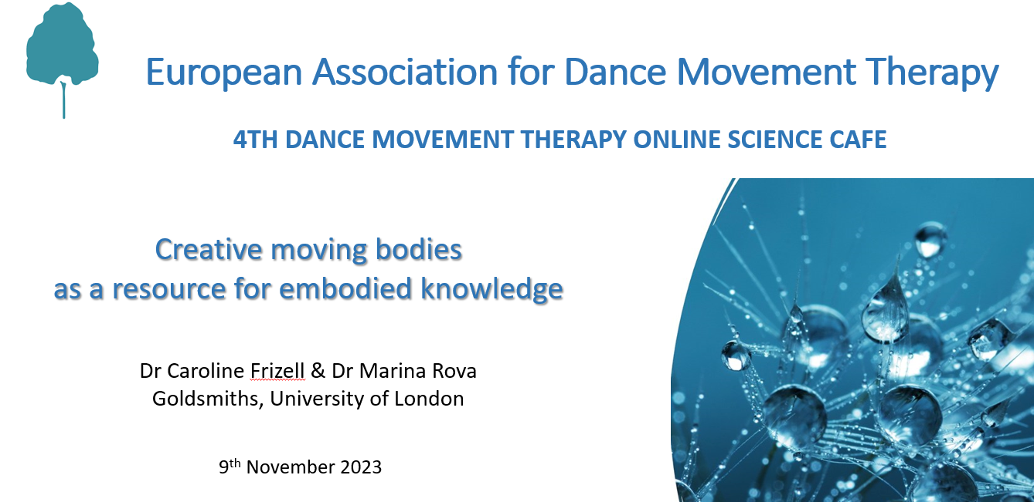
SPECIFIC ACTIONS IN 2023/24
Evaluation 4th Science Café (over 50 participants, new know-how for new events)
Discussion with first contact to WHO research series on health benefits of the arts
Small teams will support each other, when it is needed
Goodbye to Rozelien. We appreciated her time and effort!
Discussion of our resources and next steps in Research WG
Welcome to Alenka Simonic
Notes:
WHO research series on health benefits of arts: Lancet articles mostly speak about how arts practices are beneficial to Health and does mention creative arts therapies
7

Slide 8
OUTPUT YEAR 2023/2024
Keeping the Research WG together:
  3 meetings between Nov. 2023 and Sept. 2024
  Small teams met shortly as well
Collaboration with conference WG for more reviewers in the 5th conference in Vilnius (Lithuania)
Coordination Research WG and Board meeting (24th Mai)
Members situation:
  Nira Shahaf and Rozelien left the WG
  Alenka Simonic and Elien Matthiijs joined the group
  Some members stay in Background, but they show committet
Social Media visibility?

Slide 9
CURRENT MEMBERS
Elīna Cauna – Ņitavska
Silja McNamara
Simone Kleinlooh
Juliet Diener
Loredana Larionescu
Mari Mäggi
Mette Schmidt
Helle Winter
Ana Coimbra Oliveira
Paulina Jääskeläinen
Alenka Simonic
Elien Matthiijs
Coordination:
Antonella Monteleone
Eduard Martin-Colomer
From the Board:
Rosa-Maria Rodríguez-Jiménez

Slide 10
Visit and spread Citare
the 1st Journal in DMT in Spanish
https://revista.danzamovimientoterapia.com/index.php/redmt/issue/view/1
The first Spanish DMT journal is going to publish the 2nd volume this year.

Slide 11
THANK YOU FOR YOUR ATTENTION

Slide 12
SPECIFIC ACTIONS FOR 2024-25
To offer a forum to match professionals of DMT from various countries, who can collaborate in a research project or interest to present in a conference.
  Contact national associations to reach people who are active / interested in research
  Offer an online Forum to exchange knowledge and talking what are they doing
  Possibility to meet face to face in the 5th conference
To be more visible in social media
To write a letter address to WHO – Arts & Health supervised by the Board.
Next Research WG meeting: 17th January in 2025 at 7pm (CET)
Tallinn, 06/10/2024
Notes:
Be simple with our resources. Just do only step one.
Working with Communication WG
12

Slide 13
THANK YOU FOR YOUR ATTENTION
ANNUAL REPORT OF THE RESEARCH WORKING GROUP (06/10/2024)

